Slide 1
2018 Cricket World Cup Case Study
Feb 2022
Shruti Sharma

Slide 2
What was the performance of the teams based on certain criteria ? Is that criteria related to their results?
Question to be Answered

Slide 3
Top 3 countries winning the most number of ODIs

Slide 4
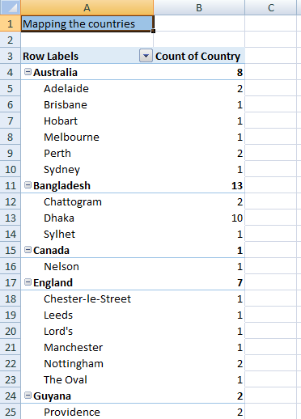
Mapping the country corresponding to the playing ground
The playing grounds corresponding to every match were given. Using spreadsheet functions , making a different column for country, the mapping of playing ground was done. This organisation made it easier finding the teams playing in native countries and foreign countries.

Slide 5
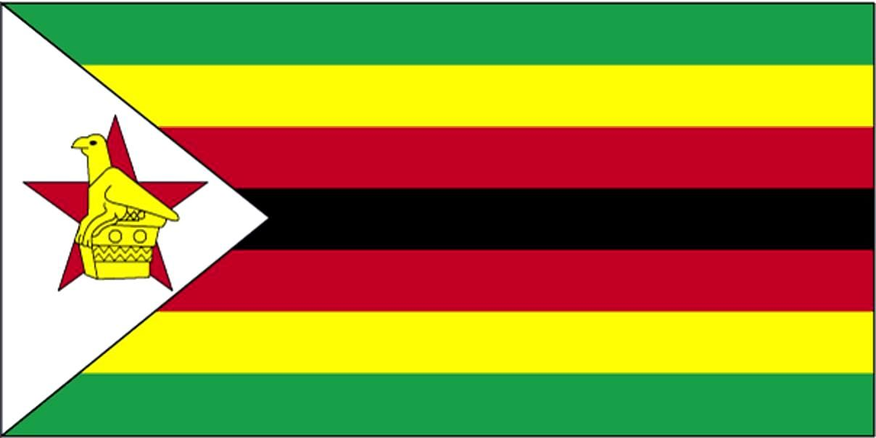
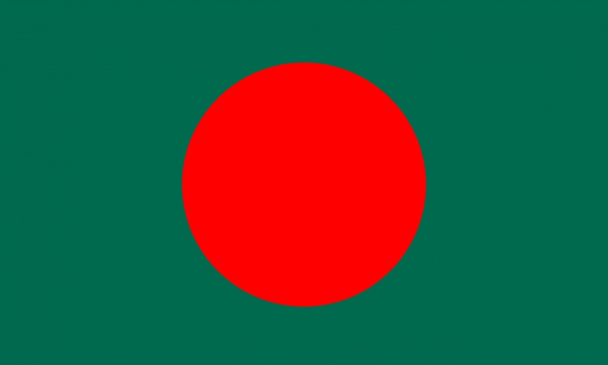
The Country who played most matches
in native ground.
Zimbabwe : 11
Bangladesh:11

Slide 6
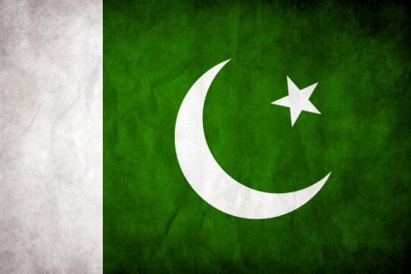
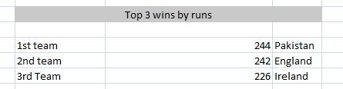
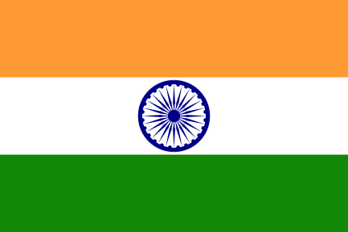

Top 3 wins by runs
1st : Pakistan
2nd : India
3rd : Ireland

Slide 7
Performance of Sri Lanka
Total

Slide 8

Did India win mostly by chasing or
playing first?

Slide 9
Country playing the most number of ODIs .

Slide 10
Ground in which most ODIS were played.

Slide 11
Does playing in native country increases the win% ?

Slide 12
Resources:
https://en.wikipedia.org/wiki/List_of_One_Day_International_cricket_grounds

